Slide 1


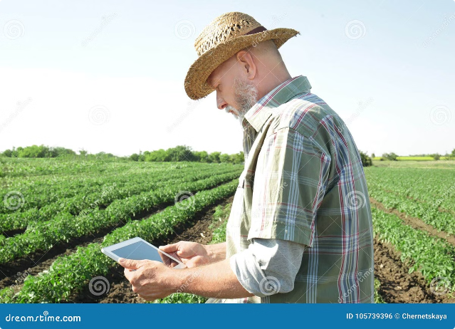
Smart Farming Optimization and Crop Analysis
This project aims to develop a comprehensive application that integrates soil analysis, and plant health monitoring to optimize farming practices, ensuring maximum crop yield and sustainability.

Slide 2
Farming Optimization
Automated Analysis
Leverage AI to analyze soil and weather data, providing tailored farming recommendations such as crop rotation, irrigation schedules, and fertilization plans.
Yield Prediction
Predict crop yields based on soil health, weather conditions, and implemented farming practices.

Slide 3

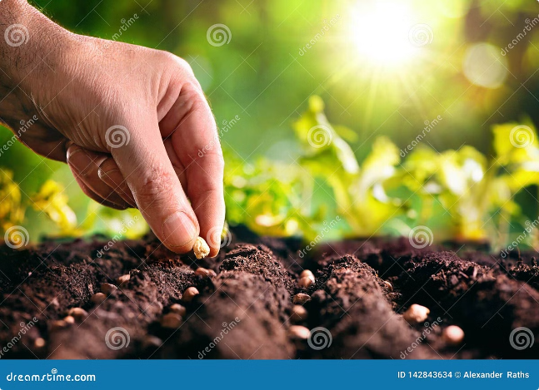
Time-to-Time Crop Plantation Based on Soil Analysis
1
Soil Nutrient Monitoring
Continuously monitor soil nutrient levels, including nitrogen, phosphorus, and potassium.
2
Crop Recommendations
Suggest the most suitable crops based on current soil conditions and nutrient levels.
3
Plantation Schedule
Provide an optimal planting schedule based on soil data to ensure crops are sown when conditions are ideal.

Slide 4

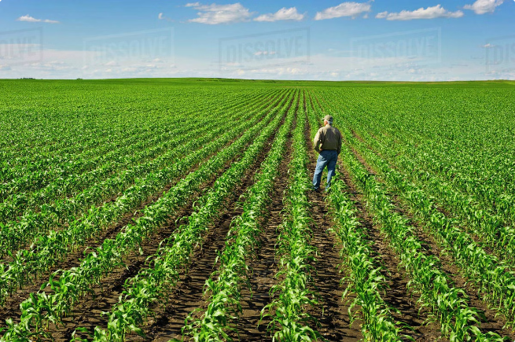
Plant Health and Leaf Analysis During Plantation Period
1
Real-Time Monitoring
Utilize sensors or image recognition technology to monitor plant health, focusing on leaf color, texture, and growth patterns.
2
Disease Detection
Early identification of diseases or nutrient deficiencies through detailed plant health analysis.
3
Health Alerts
Automatically send alerts and corrective recommendations when issues are detected.

Slide 5

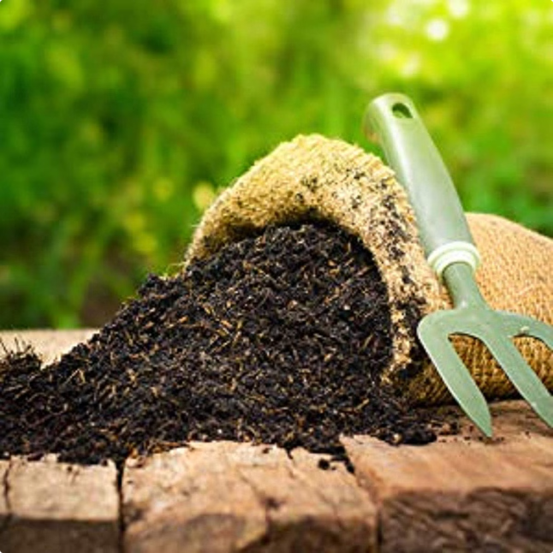
Natural Fertilizer Recommendations
Organic Fertilizer Guide
Offer recommendations for natural fertilizers tailored to the soil’s specific nutrient needs, focusing on improving soil health.
Custom Fertilizer Mixes
Suggest specific organic blends based on soil analysis, such as compost, manure, or green manure.
Sustainability Focus
Encourage the use of eco-friendly fertilizers to enhance sustainability and reduce chemical inputs.

Slide 6




Weather-Based Crop Optimization
Weather Forecast Integration
Incorporate real-time weather data to influence farming decisions, including planting times, irrigation schedules, and crop selection.
Weather Alerts
Provide alerts for extreme weather conditions (e.g., frost, drought, heavy rain) with actionable advice to mitigate potential crop damage.
Seasonal Crop Planning
Use long-term weather forecasts to recommend seasonal crops best suited to anticipated weather patterns, optimizing yield and reducing risks.

Slide 7

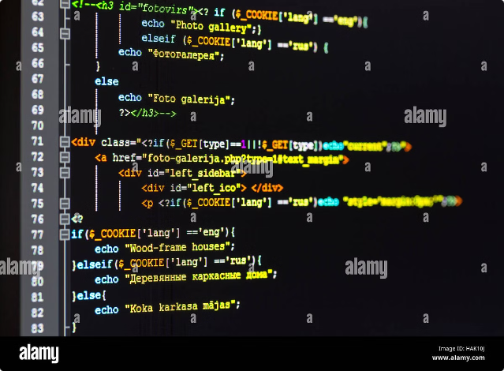
Technology Stack
Front-End
HTML, CSS, JavaScript
Back-End
Python, JavaScript
Machine Learning
TensorFlow , Computer Vision
Database
MongoDB or Firebase
Dataset
Public Dataset, Kaggle Dataset

Slide 8


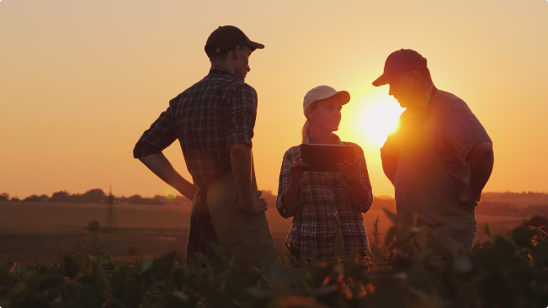


Target Audience
Farmers
Seeking to optimize crop production through precise farming practices.
Agricultural Consultants
Needing advanced tools to provide data-driven advice to clients.
Sustainable Farming Practitioners
Focused on reducing chemical usage and enhancing natural resource management.

Slide 9
Project Phases
Research & Planning
1
Define project scope and gather requirements based on farmer and industry needs. Conduct research on weather impact on farming practices and integration of soil and plant health data.
2
Design & Development
Design user-friendly interfaces that simplify navigation and usability. Develop core features, including soil and weather analysis, crop scheduling, and plant health monitoring.
AI Model Development
3
Develop AI models for plant health detection that uses computer vision and crop recommendations based on soil and weather data.
4
Testing & Validation
Conduct field tests in various farming environments to validate the app’s accuracy and effectiveness. Gather user feedback to refine features and improve overall functionality.

Slide 10

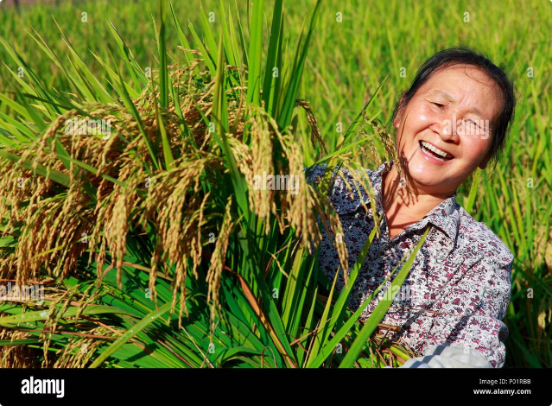
Expected Outcomes
1
Optimized Crop Yields
Improved decision-making through the integration of soil, plant, and weather data, leading to higher productivity.
2
Sustainable Farming Practices
Promotion of natural fertilizers and reduced reliance on synthetic chemicals.
3
Resilience to Weather Variability
Enhanced crop planning and management based on real-time and forecasted weather conditions, reducing risks associated with climate variability.

